Slide 1

A RGBD-Based Interactive System for Gaming-Driven Rehabilitation of Upper Limbs
《sensors》

Slide 2
Introduction
Exercises that are prescribed, regulated and controlled, help people with motor difficulties to recover mobility in the affected limbs and, therefore, quality of life.
specialized personnel(supervise the quantity and quality of the exercises)
robots
perform the exercises prescribed independently at home, without the supervision of a professional
The proliferation of increasingly cheaper sensors has allowed for the creation and development of systems capable of automatically controlling the frequency, duration and correction of the prescribed exercises.
maintain patient adherence to treatment
KineActiv(Kinect)
experiments

Slide 3
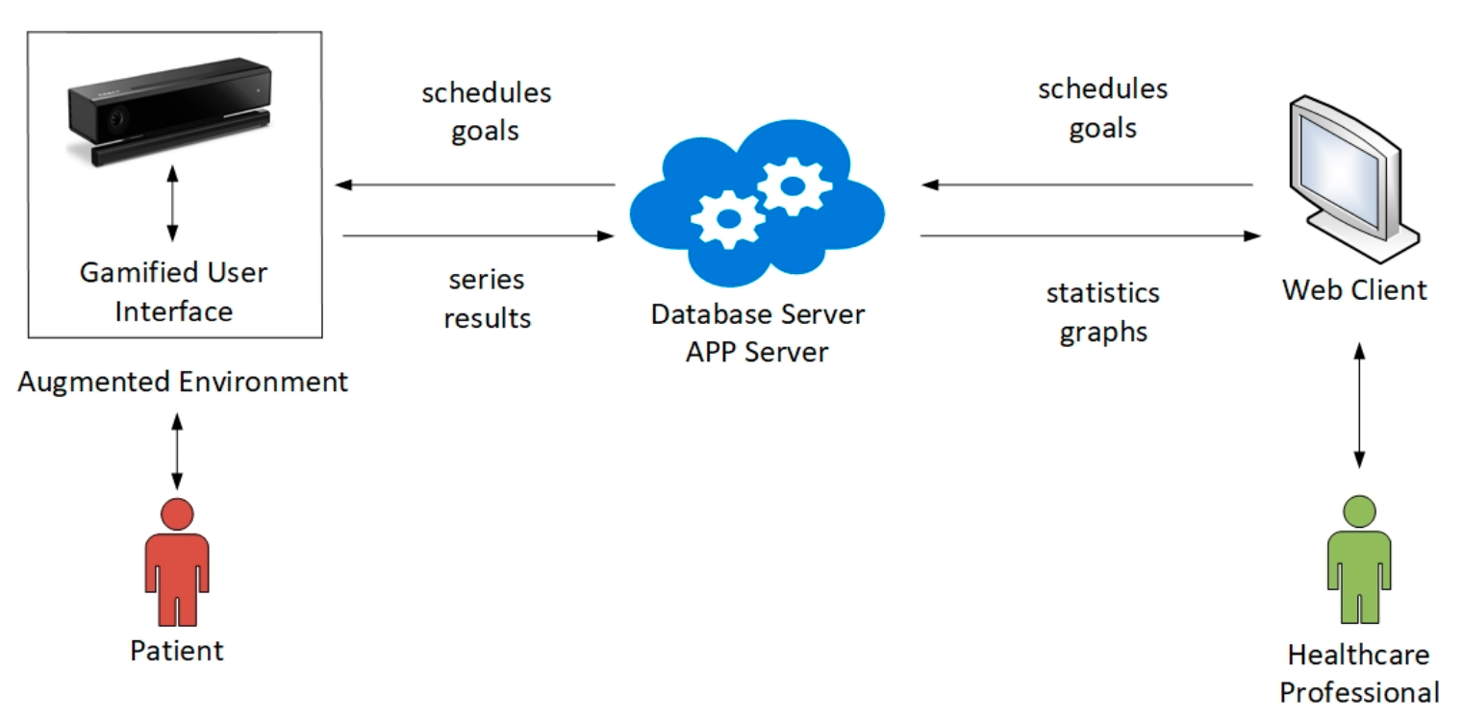
Materials and Methods
System Overview
gamified user interface(customized)
motions(tracked/measured/assessed)
client-server

Slide 4
Materials and Methods
The operational workflow of KineActiv:
Calibration
biometric data
adapts exercises
(2) Execution and control
a customized game environment
The system checks whether the execution meets the goal, according to configurable tolerance margins.
real-time visual feedback
(3) Data registration
all the series of results are stored in a database located on a server
(4) Exercise analysis and scheduling
access their private web areas
new sessions can then be scheduled

Slide 5
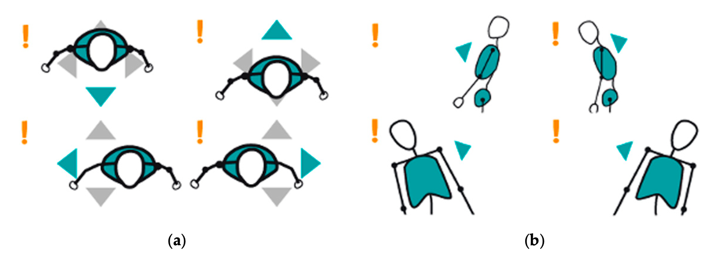
System Stages
Acquisition
The acquisition stage consists of gamified user environments developed in the Unity game engine.
the 3D coordinates of the shoulder, the elbow and the wrist (joints of interest) are obtained and tracked in real time
check whether the patient is correctly positioned and in upright posture

Slide 6
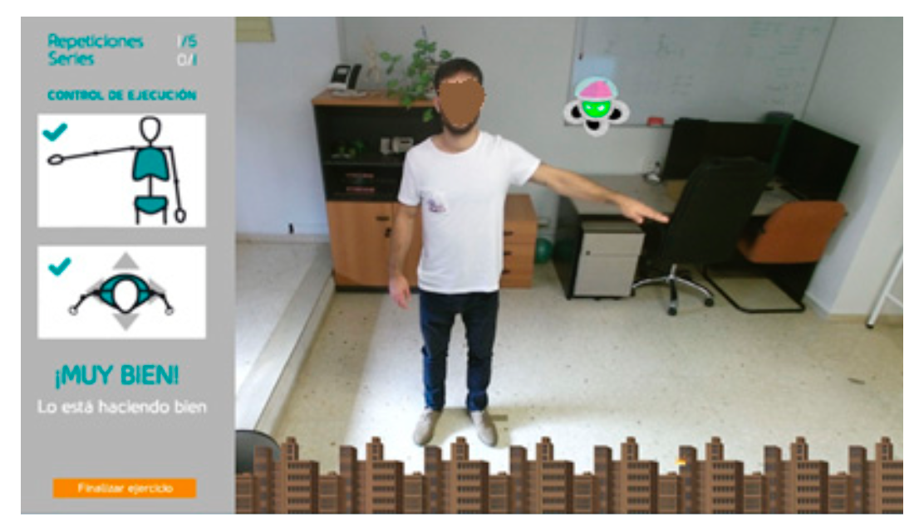
System Stages
Gamified User Environments
Concentric: repeatedly elevating the arm until reaching an objective angle
Isometric: raised until reaching an objective angle, and keeps that position for a certain period

Slide 7
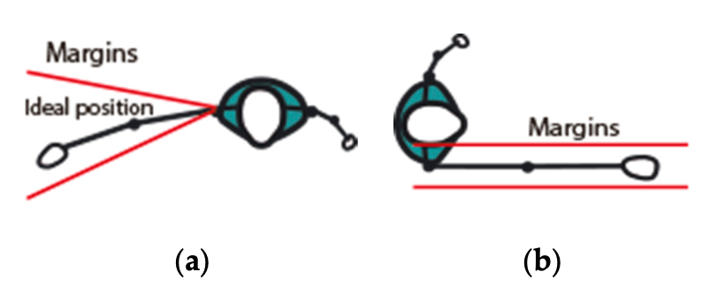
System Stages
Monitoring and Measurement
Patient-Based Calibration
capture their biometric data
limits associated to prescribed exercises can be reliably determined
abduction, flexion
Tolerance Margin Setup
a customized 3D region for each patient and exercise
outside of which any movement is considered an incorrect execution
When a joint breaks a margin, the system interprets the error, and informs the patient how to correct the exercise.

Slide 8
System Stages
Monitoring and Measurement
Joint Monitoring
Kinect provides high-precision joint coordinates 30 times per second.
more than 20 decimal places, but 3 decimal is enough
The complexity of data and software was reduced without losing effectiveness
Occlusion Handling
entail joint occlusion or loss of tracking for a small range of angles
Kinect provides estimates of the positions of the occluded joints
If the actual positions of the occluded joint just before and after the occlusion were correct, then it can be fairly assumed that the joint kept correct positions while it was occluded.
Otherwise, in case the joint had broken the alignment, it would have been detected by the sensor again, and its actual position assessed with respect to the tolerance margins

Slide 9
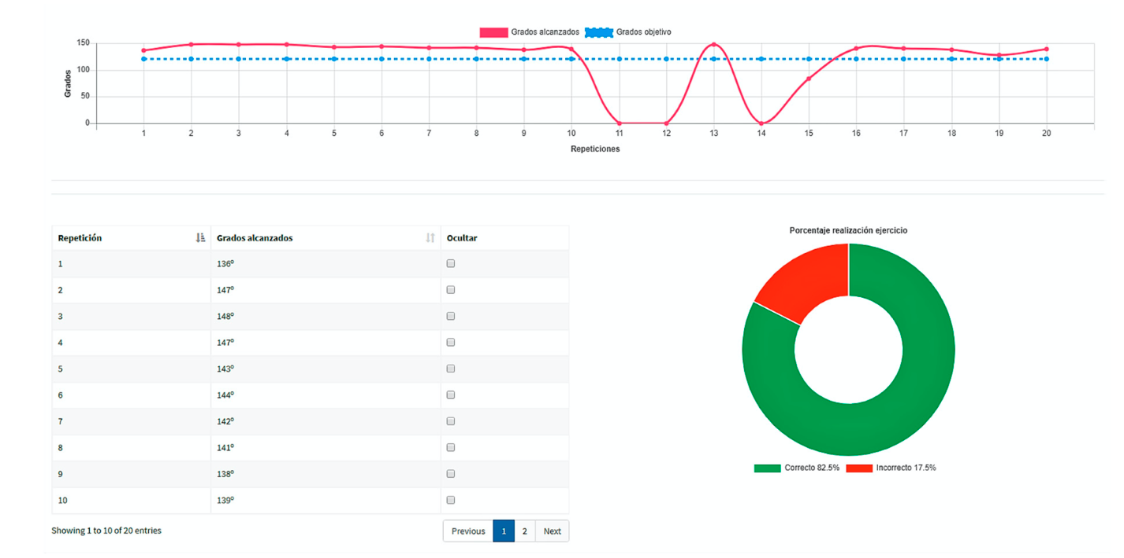
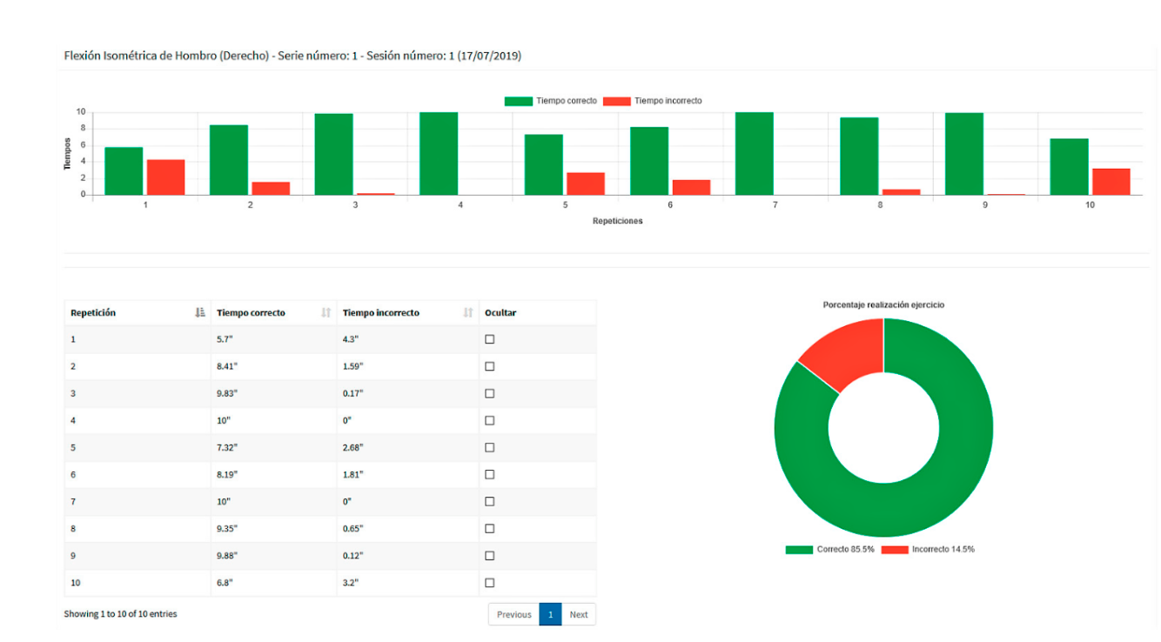
System Stages
Website
responsible
medical appointments
registering patients
scheduling rehabilitation sessions
assessing results
patients evolution
functional scopes
To prescribe an exercise routine.
To perform a system calibration.
To assess a patient ́s evolution.

Slide 10
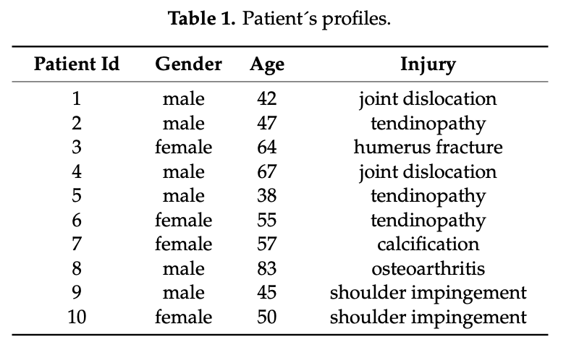
Result
Two studies
Usability study
Performance study
Participants
Ten adult patients(diagnosed arm injury, 6M4F, 38-83 years old)
recruited in the SEAP Polyclinics
four exercises: abduction, flexion, isometric, concentric

Slide 11
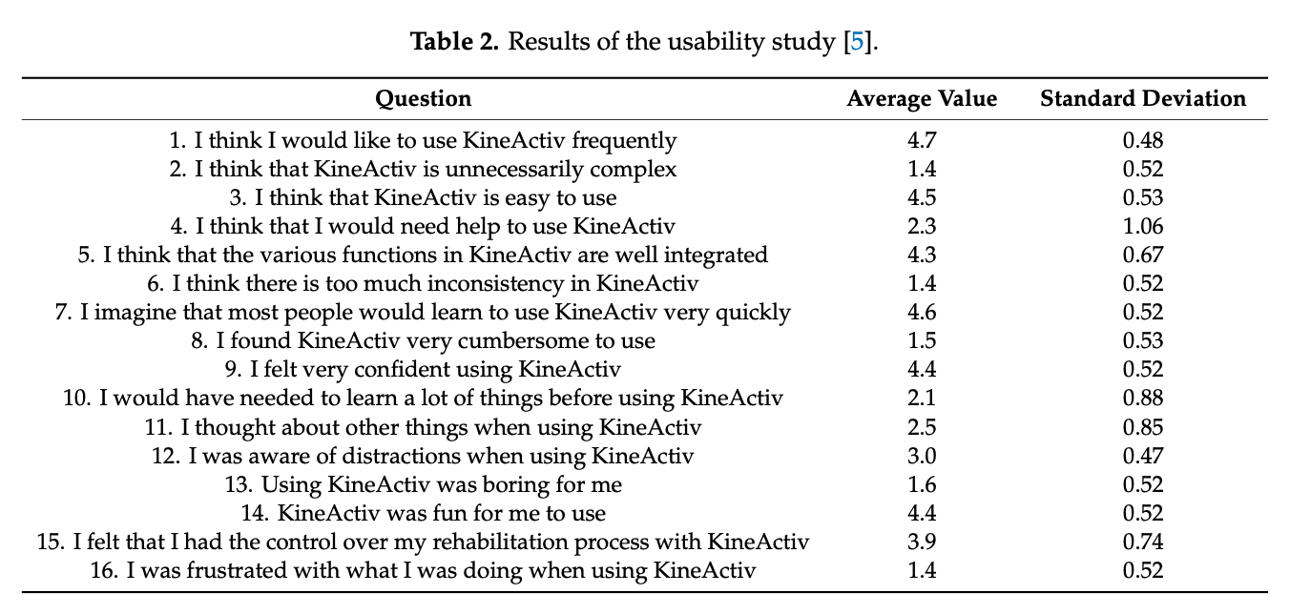
Result
Usability Study
84.5

Slide 12
Result
Performance Study
the accuracy and the sensitivity
four measures
Isometric-based measures
Isometric Abduction Index (IAI): Six daily sessions of three series of a single isometric abduction each, resulting in 18 IAI measurements in total.
Isometric Flexion Index (IFI): Six daily sessions of three series of a single isometric flexion each, resulting in 18 IFI measurements in total.
Concentric-based measures
Concentric Abduction Index (CAI): Six daily sessions of three series of 20 concentric abductions each, resulting in 360 CAI measurements in total.
Concentric Flexion Index (CFI): Six daily sessions of three series of 20 concentric flexions each, resulting in 360 CFI measurements in total.

Slide 13
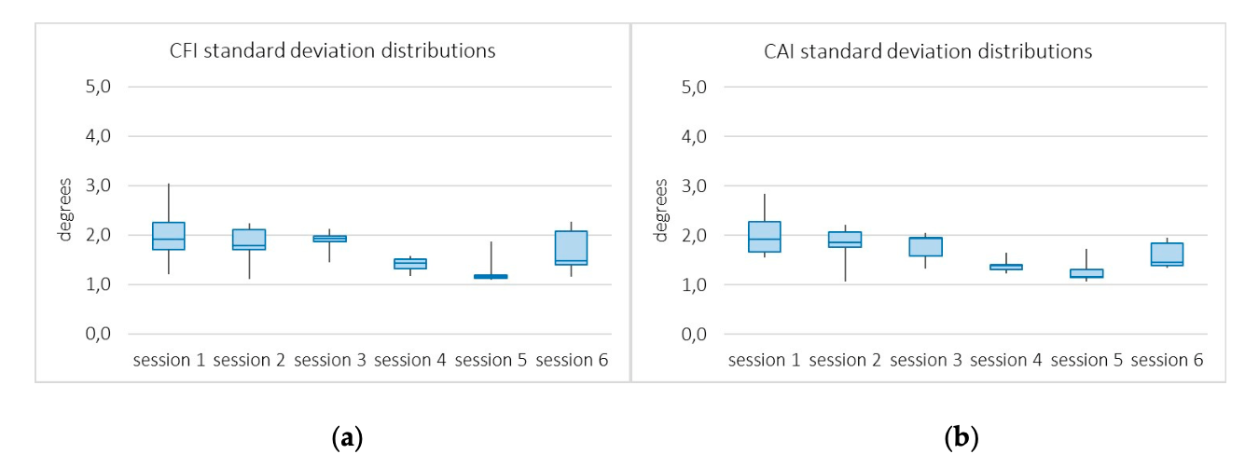
Result
System Accuracy
two analyses
(1)
a healthy physiotherapist(perform an abduction and a flexion up to 80◦)
abduction(80.12◦, 0.15%), flexion(80.06◦, 0.075%)
IAI = 43.65 s, IFI = 44.05 s, CAI = 120◦, CFI = 120
(2)
the distribution of standard deviations of CAI and CFI across patients

Slide 14
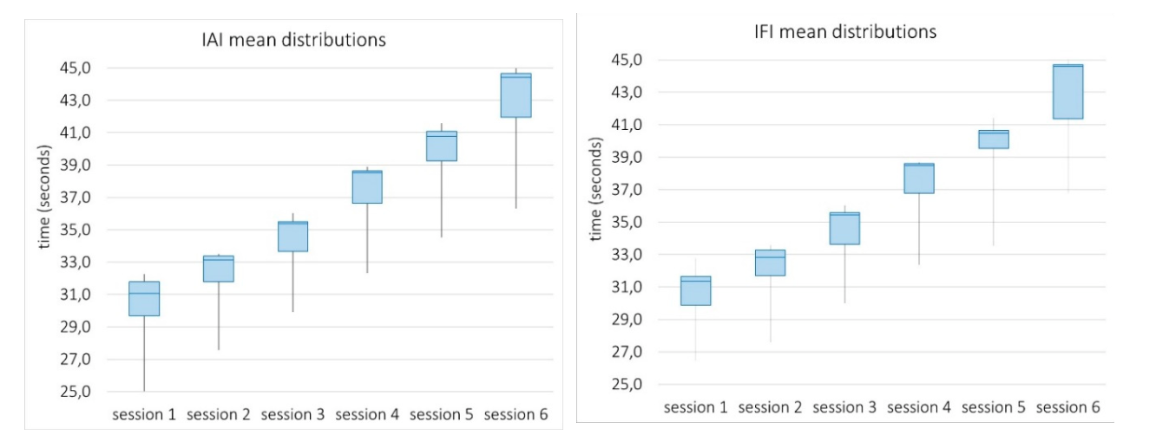
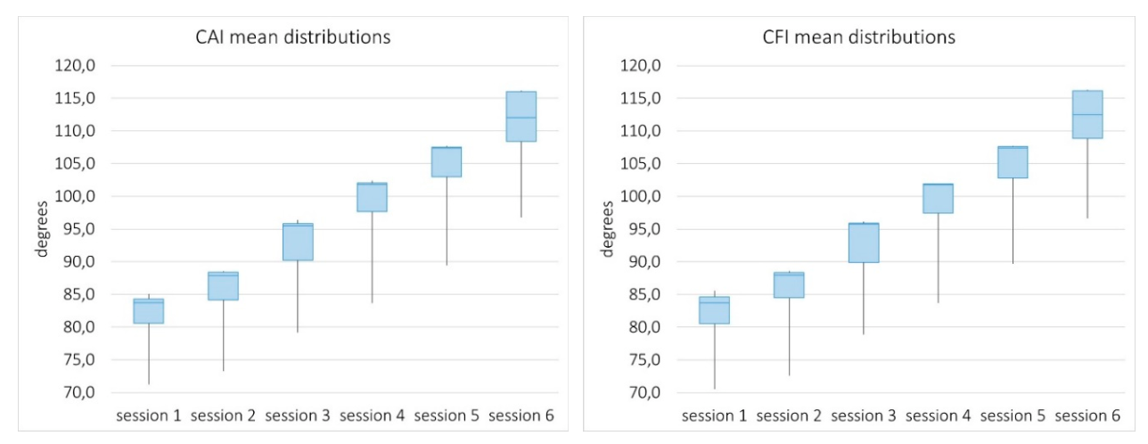
Result
System Sensitivity

Slide 15
Conclusions
This work has presented a RGBD-based interactive system (KineActiv) which proposes a holistic approach to the rehabilitation of upper limbs.
The system guides patients through customized games on augmented scenes, which aims at encouraging patients to achieve a number of goals established by the physiotherapist.
Two studies were conducted to evaluate KineActiv based on the experience of ten patients.
Several issues remain for future research.
new exercises
associated games to rehabilitate any part of the body
improve the quality of games with better graphics and more engaging goals

